Slide 1

MOSE: Practical Multi-User Oblivious Storage via Secure Enclaves
The 10th ACM Conference on Data and Application Security and Privacy (CODASPY 2020)
Thang Hoang†, Rouzbeh Behnia†, Yeongjin Jang‡, Attila A. Yavuz†
† University of South Florida, Tampa, FL
‡ Oregon State University, Corvallis, OR

Slide 2


Introduction
Data outsourcing provides efficient storage infrastructure for multiple remote clients accessing a shared/standalone database
With many practical attacks being demonstrated recently [IKK12, LZW+14, ZKP16], access pattern leakage is one of the most security concerns in data outsourcing applications
Server
Client
Outsourced Data
access / search / update / compute
access pattern leakage
Statistical inference attacks [IKK12, LZW+14, ZKP16]
Notes:
Merge with slide 3 with animation about leakage

Slide 3



Motivation
Oblivious Storage (OS) [SZA+16, SS13] uses Oblivious RAM (ORAM) [GO96] to enable multiple clients accessing a shared database without leaking access pattern of individuals
State-of-the-art OS design [SZA+16] harnessed a trusted proxy to execute ORAM protocol for parallel access
Performance is capped by the network bandwidth between the proxy and storage server
Dedicate Proxy
Up to 10 concurrent requests under 1Gbps network
Untrusted Storage
ORAM Controller
hidden access pattern
Capped by network bandwidth
Is there any way to execute ORAM more efficiently?
Use secure hardware!
Trusted Execution Environment (TEE) becomes widely available (e.g., Intel-SGX)

Slide 4
Our Contributions
MOSE: A new multi-user oblivious storage design with Intel-SGX
Harness and optimize the most suitable cryptographic primitives for secure hardware
(Recursive) Circuit-ORAM
Respect secure hardware constraints
Limited memory (95 MB for Intel-SGX)
Prevent common side-channel leakages (e.g., conditional branches)
Support critical features for multi-user setting
Access control enforcement against active adversary
Scalable to multi-user concurrent access
Implementation and evaluation with large DB
Approach | Throughput (req/s) | Latency (ms)
TaoStore | 10 | 525 - 731
MOSE | 374 | 13 - 21
Notes:
99.5 faction means 99.5% of keywords only returns a small amount of files. There are 0.5% keywords that appears in every file. In this case, downloading everything is better than running ORAM because of O N log N vs O N
Prevent side-channel access pattern leakages (explain?)
- Because the secure hardware resides in the untrusted server, even though adversary cannot tamper with it, he can observe from outside how the CPU accesses the encrypted memory (e.g., if condition check, some variables inside the enclave are accessed more frequently than others). This can lead to the access pattern leakage. We need to ensure that the CPU access the memory uniformly so that adv cannot distinguish the access pattern

Slide 5

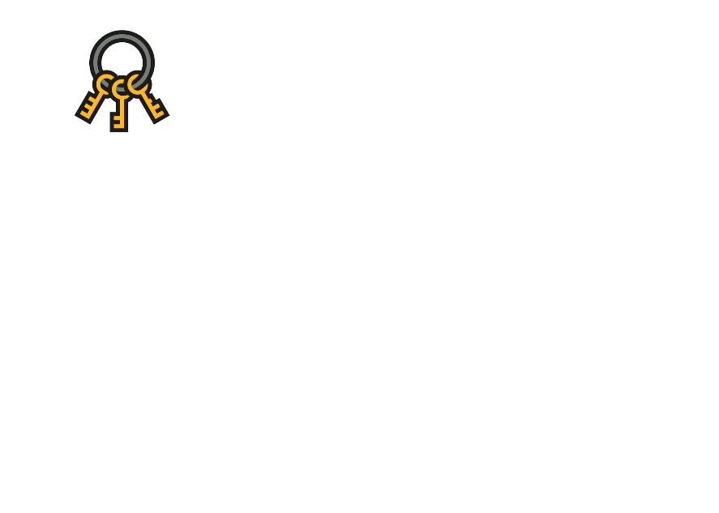





MOSE Design Overview
Remote Server
Untrusted Memory
Enclave
Alice
Access DB
~50 msec
Access DB
ORAM Controller
Bob
Permission check
Access DB
Access DB
DB
Carol
Dave
Notes:
99.5 faction means 99.5% of keywords only returns a small amount of files. There are 0.5% keywords that appears in every file. In this case, downloading everything is better than running ORAM because of O N log N vs O N
Prevent side-channel access pattern leakages (explain?)
- Because the secure hardware resides in the untrusted server, even though adversary cannot tamper with it, he can observe from outside how the CPU accesses the encrypted memory (e.g., if condition check, some variables inside the enclave are accessed more frequently than others). This can lead to the access pattern leakage. We need to ensure that the CPU access the memory uniformly so that adv cannot distinguish the access pattern

Slide 6
Secure Enclaves [JSR+16]
Intel-SGX provides an enclave with hardware-based isolated, encrypted and integrity-protected memory
Prevent any execution outside the enclave from accessing enclave’s data
Memory
EPC
Enclave
SGX
CPU
Secret Data
…
Encrypted and integrity-protected by
X
ECALL
OCALL
Untrusted component 1
Untrusted component 2
Untrusted component 3
Notes:
Re-write the things in more detail as in the paper

Slide 7
Circuit-ORAM [WCS15]
Follows tree paradigm [SCS+11] with two main phases
Read: Entire path but only put 1 block to the stash
Eviction: Push blocks to deeper levels as much as possible in a single scan
Evict path: Deterministic, reverse lexicographic order
Real block
Dummy block
Stash S
Position map
5
Block ID | Path ID
1 | 2
2 | 5
3 | 7
4 | 3
5 | 4
6 | 2
7 | 1
1
Bucket Size Z = 2
|S| = 80
2
7
6
4
3
1 2 3 4 5 6 7 8
Path ID
Notes:
Tree-ORAM paradigm:
Read a path
Assign the block to a new random path and (possibly) put it in the Stash
Run the eviction to put the block from stash back to the tree
Path-ORAM vs. Circuit-ORAM
CircuitORAM reads only 1 block to the stash, while Path-ORAM maybe OlogN
Path-ORAM evict OlogN blocks from stash to the tree, Circuit-ORAM only push 1 block
CircuitORAM works better with deterministic eviction, while Path-ORAM must be probabilistic

Slide 8



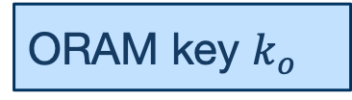
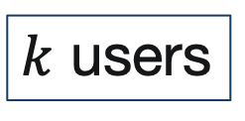
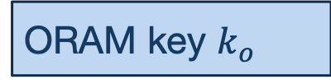
MOSE: Initialization
Untrusted Memory
Data Owner
EAC
PosMap
DB
EAC
(+ Stash)
Gen
EDB
PosMap
SERVER
$k$ users
EDB
(+ Stash)
Secure Enclave
Secure channel via remote attestation
ORAM key $k_{o}$
ORAM key $k_{o}$
Notes:
File is indexed from 1 to N -> possible to apply recursive ORAM to store the path of EACH file
EACH file contains multiple chunks -> possible to use ODS to reduce the size of recursive ORAM (not need to store the path of non-root blocks
TW has hashing mechanism -> not using ORAM/ODS, but TW only store the path of FIRST block in the linked-list

Slide 9


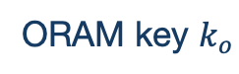



MOSE: Access Workflow
USER
SERVER
Secure Enclave
Untrusted Memory
Session key $k_{uid}$
ORAM key $k_{o}$
(uid,pwd,
bid,op)
(uid,pwd,bid,op)
(uid,pwd)
no
Reject
Auth
(uid,bid)
(Recursive)
Circuit ORAM
$${bid}^{′}$$
EAC
PosMap
pid’
Circuit ORAM
EAC
$$B_{{bid}^{′}}$$
no
$$op∈B_{{bid}^{′}}$$
CPU & I/O Parallelization
yes
bid
Dummy ID
(Recursive)
Circuit ORAM
EDB
PosMap
pid
Circuit ORAM
EDB
Block
Block
Notes:
Accessing the first block of everything, therefore ODS cannot help
Given the target file, we first access its head, recurise ORAM is used to fetch to get the path of the information on the first block

Slide 10
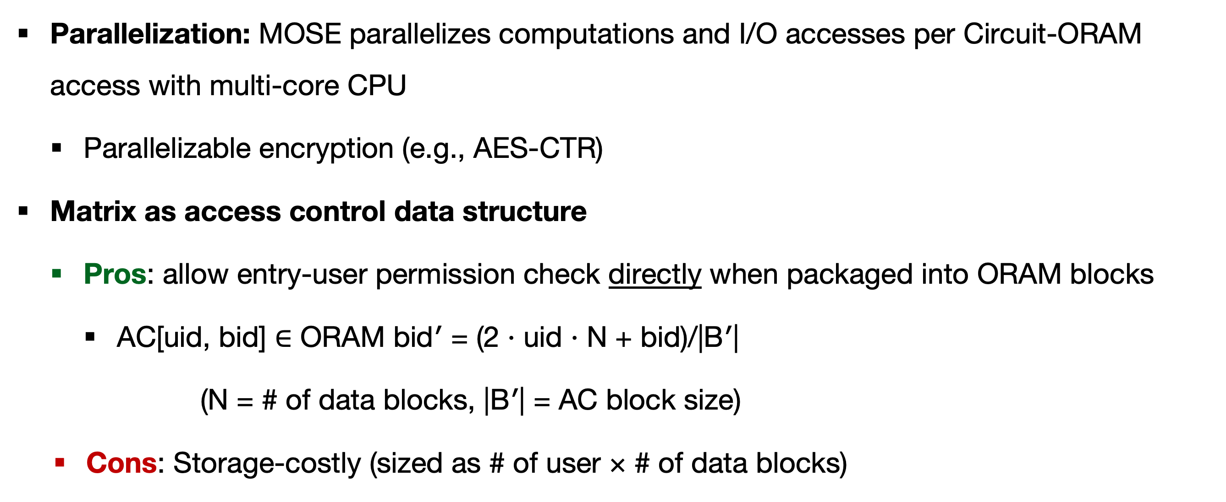
MOSE: Toward Scalable Access
Parallelization: MOSE parallelizes computations and I/O accesses per Circuit-ORAM access with multi-core CPU
Parallelizable encryption (e.g., AES-CTR)
Matrix as access control data structure
Pros: allow entry-user permission check directly when packaged into ORAM blocks
AC[uid, bid] $∈$ ORAM bid′ = (2 · uid · N + bid)/|B′|
(N = # of data blocks, |B′| = AC block size)
Cons: Storage-costly (sized as # of user × # of data blocks)
Notes:
File is indexed from 1 to N -> possible to apply recursive ORAM to store the path of EACH file
EACH file contains multiple chunks -> possible to use ODS to reduce the size of recursive ORAM (not need to store the path of non-root blocks
TW has hashing mechanism -> not using ORAM/ODS, but TW only store the path of FIRST block in the linked-list

Slide 11
MOSE: Hiding side-channel access pattern
Conditional execution (if/else st.): Distinguishable access pattern due to execution branches
Use CMOV and SETE/SETG/SETGE for oblivious comparison and update [OSF+16]
Notes:
Diff color match with prev slide

Slide 12
Experiment: Configuration
Hardware: Intel Core i7-8700K CPU @ 3.70 GHz, 32 GB DDR4-2133, 4 TB NVMe
Dataset: 768 GB random DB (2²⁵ entries). Basic 2-bit access policies (read and/or write) for 2¹⁴ users on 2²⁵ entries. Block size: 24 KB for DB entries, 12 KB for access control entries.
Network: 50 ms latency
MOSE Parameters: Circuit-ORAM with stash size |S| = 80, bucket size Z = 2, deterministic eviction, recursive compression ratio = 256
Compared counterpart: TaoStore [SZA+16]
Standard Path-ORAM parameters: Z = 4, |S|= 80
1 Gbps network with 10 ms latency between proxy and storage server

Slide 13
Experiment: Results (1/3)
MOSE (without optimization) offers 53 - 200 ops for database sizes from 6 - 768 GB
MOSE delay in processing one request
Cost breakdown

Slide 14
Experiment: Results (2/3)
Optimization factors
k-top caching, position map & stash caching
Parallelized crypto operations
Optimized MOSE offers a throughput of 374 ops

Slide 15
Experiment: Results (3/3)
MOSE latency is 13-21 ms per request (vs. 525–731 ms in TaoStore)
MOSE was 34.80 - 37.8× faster than TaoStore
Comparison with the state-of-the-art

Slide 16
Conclusion
Designed MOSE, a practical multi-user oblivious storage with access control that enables secure and efficient data outsourcing on the cloud.
Demonstrated the practicality of using secure enclaves to enable oblivious data outsourcing applications
Mitigate the impact of network bandwidth bottleneck
Scalability
Access control enforcement
Resiliency against active adversaries

Slide 17
References
[GO96] Goldreich, Oded, and Rafail Ostrovsky. "Software protection and simulation on oblivious RAMs." Journal of the ACM (JACM) 43, no. 3 (1996): 431-473.
[WCS15] Wang, Xiao, Hubert Chan, and Elaine Shi. "Circuit oram: On tightness of the goldreich-ostrovsky lower bound." In Proceedings of the 22nd ACM SIGSAC Conference on Computer and Communications Security, pp. 850-861. ACM, 2015.
[SCS+11] Shi, Elaine, T-H. Hubert Chan, Emil Stefanov, and Mingfei Li. "Oblivious RAM with O ((logN) 3) worst-case cost." In International Conference on The Theory and Application of Cryptology and Information Security, pp. 197-214. Springer, Berlin, Heidelberg, 2011.
[ZKP16] Zhang, Yupeng, Jonathan Katz, and Charalampos Papamanthou. "All your queries are belong to us: The power of file-injection attacks on searchable encryption." In 25th {USENIX} Security Symposium ({USENIX} Security 16), pp. 707-720. 2016.
[LZW+14] Liu, Chang, Liehuang Zhu, Mingzhong Wang, and Yu-An Tan. "Search pattern leakage in searchable encryption: Attacks and new construction." Information Sciences 265 (2014): 176-188.
[IKK12] Islam, Mohammad Saiful, Mehmet Kuzu, and Murat Kantarcioglu. "Access Pattern disclosure on Searchable Encryption: Ramification, Attack and Mitigation." In Ndss, vol. 20, p. 12. 2012.
[SZA+16] Cetin Sahin, Victor Zakhary, Amr El Abbadi, Huijia Lin, and Stefano Tessaro. 2016. Taostore: Overcoming asynchronicity in oblivious data storage. In Security and Privacy (SP), 2016 IEEE Symposium on. IEEE, 198–217
[SS13] Emil Stefanov and Elaine Shi. 2013. Oblivistore: High performance oblivious cloud storage. In Security and Privacy (SP), 2013 IEEE Symposium on. IEEE, 253–267.
[JSR+16] Johnson, Simon, Vinnie Scarlata, Carlos Rozas, Ernie Brickell, and Frank Mckeen. "Intel® software guard extensions: Epid provisioning and attestation services." White Paper 1 (2016): 1-10.
[OSF+16] Ohrimenko, Olga, Felix Schuster, Cédric Fournet, Aastha Mehta, Sebastian Nowozin, Kapil Vaswani, and Manuel Costa. "Oblivious multi-party machine learning on trusted processors." In 25th {USENIX} Security Symposium ({USENIX} Security 16), pp. 619-636. 2016.

Slide 18
Thank you for your attention!
?
Contact: {hoangm,behnia,attiaayavuz}@usf.edu, yeongjin.jang@oregonstate.edu

